Slide 1
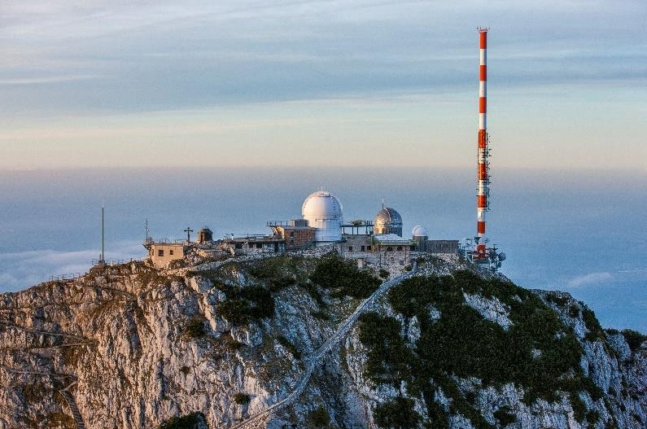
OCP-TAP SESSION 6.12.2023 5G BASED PNT USING TV TRANSMITTERS
Stefan Maier
R&S Location Based Services Lab

Slide 2
THE PROBLEM
GNSS is the „gold standard“ for uncountable timing users with sub-1µs demand
free-of-charge
afordable receivers
UTC
decent accuracy
often the source of PTP masters
Few clients have direct PTP link to NIST, PTB, …
What if GNSS is not available?
PTP from an atomic clock ensemble
NIST
PTB
USNO
GPS
What if you can‘t easily connect to the ensemble with PTP?
Or you‘re in motion?
Could we use another RF signal as a time source?
PTP
client
PTP
client
PTP
master
Rohde & Schwarz
12/06/2023 5G based PNT Using TV Transmitters

Slide 3
BROADCASTING TIME – TECHNOLOGIES, ACCURACIES
GNSS performance:
few ns
Long wave, DCF77 in Europe, WWVB in US, JJY in Japan, …
few µs in best case, cheaper receivers: tens of µs
https://www.ptb.de/cms/fileadmin/internet/fachabteilungen/abteilung_4/4.4_zeit_und_frequenz/pdf/2004_Piester_-_PTB-Mitteilungen_114.pdf
Accuracy limited by narrow bandwidth
Broadcast systems:
FM (RDS) ~100 ms
DVB-T2 ~0.3 µs on PHY, but not UTC traceable
up to 1 s (!) error for UTC time in payload
Synchronized Delivery of Multimedia Content over Uncoordinated Broadcast Broadband Networks, Concolato et. al
5G cellular*
???
Cellular 5G networks
5G TDD requires 1.5 µs vs. UTC
In practice: 50 ns to 1.5 µs
*) UTC broadcast is optional – often not sent
DVB-T2 FM UTC Time RDS
DCF77 WWVB
GNSS
s
ms
µs
ns
ps
NTP
PTP
PTP-WR
Difficult to assure performance of 10000+ base stations
Rohde & Schwarz
12/06/2023 5G based PNT Using TV Transmitters

Slide 4
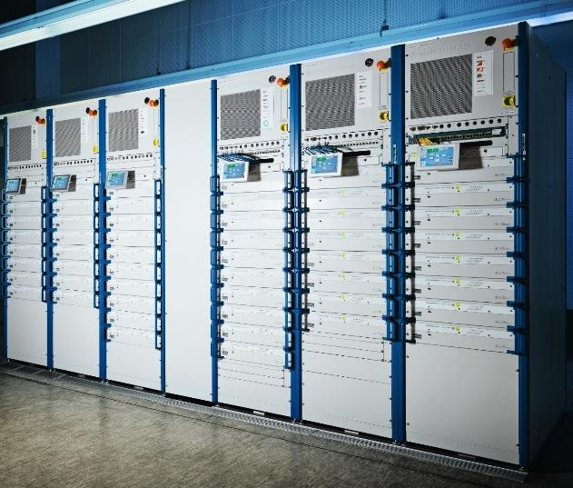
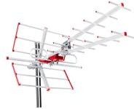
USING TV SIGNALS AS A TIME SOURCE?
Could be built independent of GNSS
Less vulnerable to solar storm, jamming, spoofing
High power signal (100kW to 1000kW ERP)
World-wide UHF band (~450-600/700 MHz)
Electricity backup at many transmitters
Very high availability
Infrastructure is already in place
6-8 MHz bandwidth → many GPS receivers don‘t use more either
~100 towers to cover a country like Germany
Monitoring and synchronization is manageable
Cheap directional antennas – hard to jam
< 100 $
Amplifiers for a 1 MW transmitter
Rohde & Schwarz
12/06/2023 5G based PNT Using TV Transmitters

Slide 5
THREE CHALLENGES
Signal for afordable timing receivers
There is not „the single“ digital TV standard for the world
Should have a lower-layer UTC timestamp
Should not be proprietary
Improve the accuracy of transmitters for sub-µs use cases
Distributing GNSS-independent time to each TV transmitter
Rohde & Schwarz
12/06/2023 5G based PNT Using TV Transmitters

Slide 6

1 – THE SIGNAL
Cíeated with Bing image cíeatoí
Rohde & Schwarz
12/06/2023 5G based PNT Using TV Transmitters

Slide 7
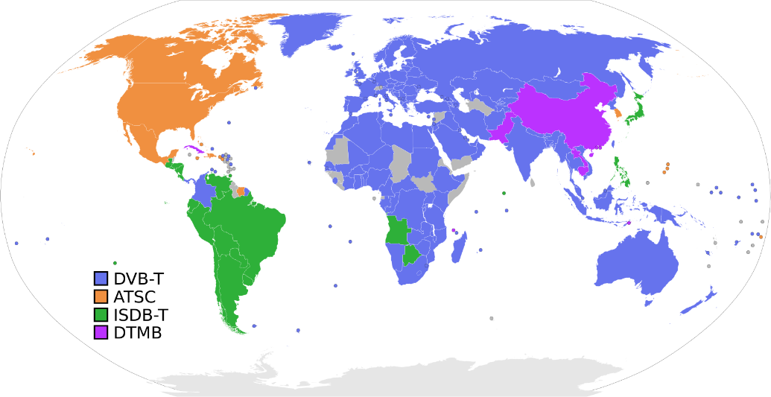
DIGITAL TV STANDARDS
Digital TV transmitters are software-defined-radios
They can be re-configured for ATSC 3.0, DVB-T2, ISDB-T, DTMB, feMBMS
There is not a global standard
Which one to use?
We chose 3GPP feMBMS (currently in trial stage)
Another independent project chose ATSC 3.0
Essentially any of these standards could be extended
to carry a UTC time stamp
Rohde & Schwarz
12/06/2023 5G based PNT Using TV Transmitters

Slide 8
FEMBMS?
feMBMS: „LTE for Broadcasting from TV towers“
Standard by 3GPP (the standardization body that brought you 4G and 5G)
Essentially some kind of LTE signal
offers the timing and positioning features from the 3GPP „toolbox“
e.g. a UTC timestamp normal phones can read already
Enabling low-cost mass-market receivers (Essentially a LTE modem with some SW modifications)
SW-Modified smartphones able to receive feMBMS signals already today
https://youtu.be/03h8dJTIEUo?si=xB8EjKTiNIY5z5PI&t=76
Rohde & Schwarz
12/06/2023 5G based PNT Using TV Transmitters

Slide 9
DIFFERENCES LTE VS. FEMBMS SIGNAL
 | Normal LTE | feMBMS
Uplink | yes | No
Subcarrier spacing | 15 kHz | 15 kHz, 2.5 kHz, 1.25 kHz or 0.625 kHz
Cyclic Prefix | 16.67µs | 400µs, 800µs, 1600 µs
UTC time broadcast | SIB16 | SIB16
Transmitter location broadcast | standardized | Can be added
Application | Cellular network | Broadcasting towers
Rohde & Schwarz
12/06/2023 5G based PNT Using TV Transmitters

Slide 10
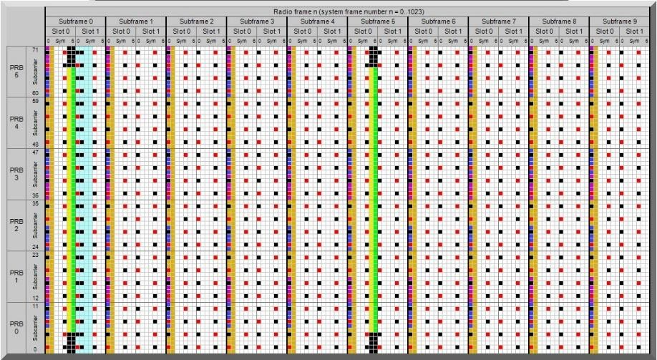
HOW DOES THE LTE/FEMBMS SIGNAL LOOK LIKE?
Source: http://paul.wad.homepage.dk/LTE/lte_resource_grid.htm
OFDM signal
5-8 MHz Bandwidth
15 kHz subcarrier spacing (2.5, 1.25, 0.625 also allowed)
10 ms Frame length
Several pilot signals:
Primary Synchronization Signal
Secondary Synchronization Signal
Cell-Specific Reference signals
Receiver reads time information from System Information Block:
MIB: Master Information Block fundamental data of cell
SIB1: Containing info where to find the other SIBs (i.e. SIB16)
SIB16: UTC time of frame start
Including leap seconds vs. GPS
Rohde & Schwarz
12/06/2023 5G based PNT Using TV Transmitters

Slide 11
HOW TO GET THE PRECISE UTC TIME FROM LTE/FEMBMS
Specified in 3GPP 36.311
SystemInformationBlockType16 (simplified)
timeInfo
timeInfoUTC INTEGER (0..549755813887),
dayLightSavingTime BIT STRING (SIZE (2))
leapSeconds INTEGER (-127..128)
localTimeOffset INTEGER (-63..64)
“timeInfoUTC: Coordinated Universal Time corresponding to the SFN boundary (…). The field counts the number of UTC seconds in
10 ms units since 00:00:00 on Gregorian calendar date 1 January, 1900 (…). NOTE 1.
NOTE 1: The UE may use this field together with the leapSeconds field to obtain GPS time”
Rohde & Schwarz
12/06/2023 5G based PNT Using TV Transmitters

Slide 12
HOW ABOUT TX LOCATION?
TX location: posSIB
However, small gap in 3GPP feMBMS standard: would require a change request to be standard compliant for broadcasting mode
Specified in 3GPP 37.355:
NR-UEB-TRP-LocationData
nr-trp-LocationInfo NR-TRP-LocationInfo-r16,
nr-dl-prs-BeamInfo
Can encode TX location, incl. antenna phase center, beam direction
Rohde & Schwarz
12/06/2023 5G based PNT Using TV Transmitters

Slide 13
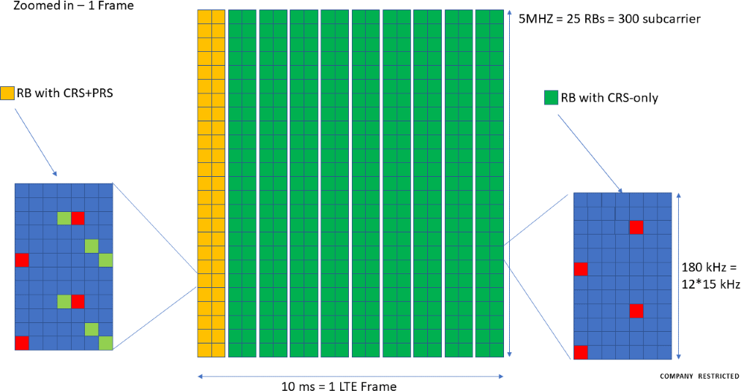
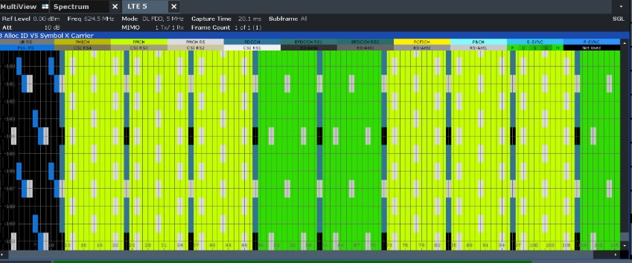
TRANSMITTER - ENHANCEMENTS
Implemented SIB16 for UTC timing
Added PRS
Planned: Add posSIBs: Identified necessary extensions in 3GPP for broadcast mode

Slide 14
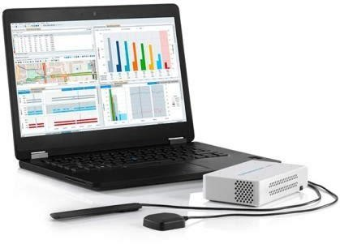
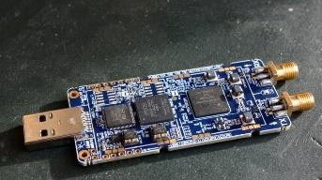
TEST RECEIVERS
Receiver A: R&S TSME Measurement receiver
~10 ns TDOA accuracy, ~15
ns TOA accuracy
PPS-out for timing applications
Receiver B: OBECA Open- source SDR based on LimeSDR
Affordable “starter-kit” for
universities, students, …
No PPS out

Slide 15
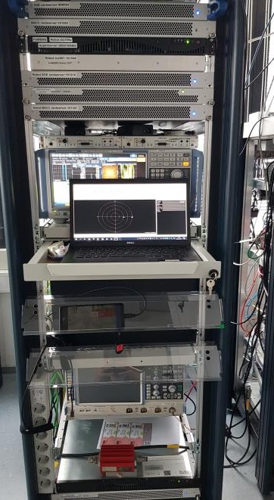
2 - ACCURACY
TV transmitter #1
TV transmitter #2
PC connected to receiver
TV transmitter #3
TSME receiver (not visible here)
No amplifiers, few Watt max power
Lab test setup used to improve the jitter
12/06/2023 5G based PNT Using TV Transmitters

Slide 16
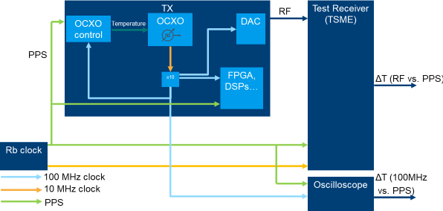
TRANSMITTER SEGMENT
Simplified TV transmitter diagram including measurement devices

Slide 17
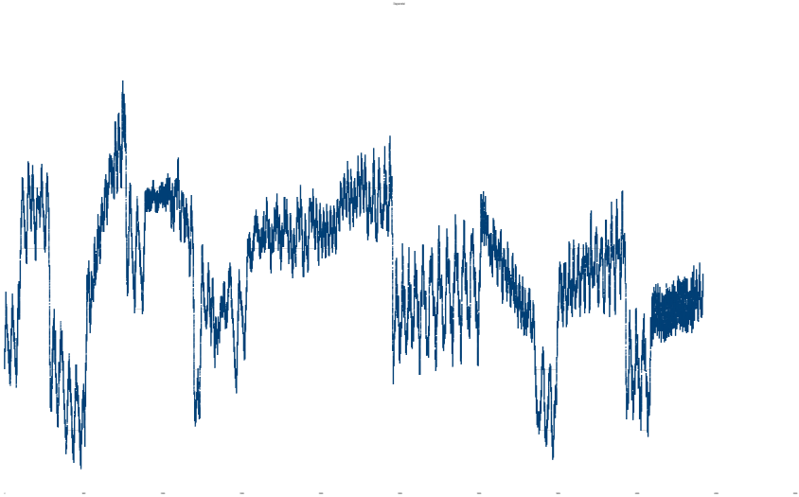
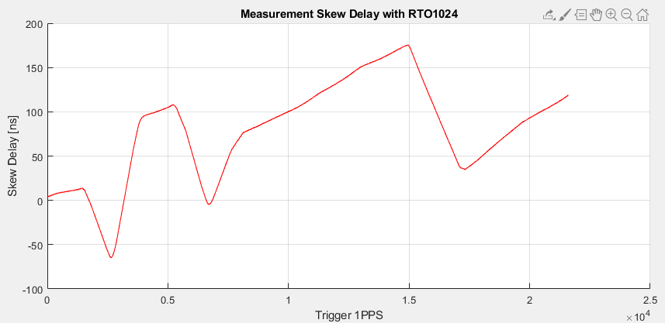
TRANSMITTER ACCURACY – STATUS QUO
Accuracy-Analysis of RF Signal jitter (before this project)
The transmitter’s OXCO error is the main error source of the RF signal’s time inaccuracy
Error contribution ~ 100 m
(300 ns)
Other Periodic and systematic errors visible
Targeted Optimizations
during this project:
Improve OCXO control
Improve SFN regulator

Slide 18
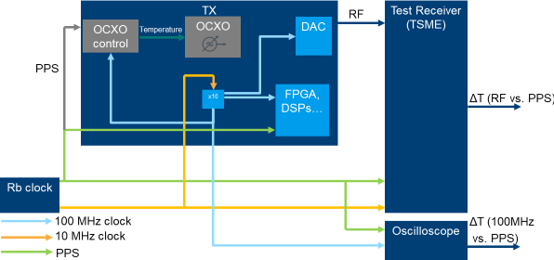
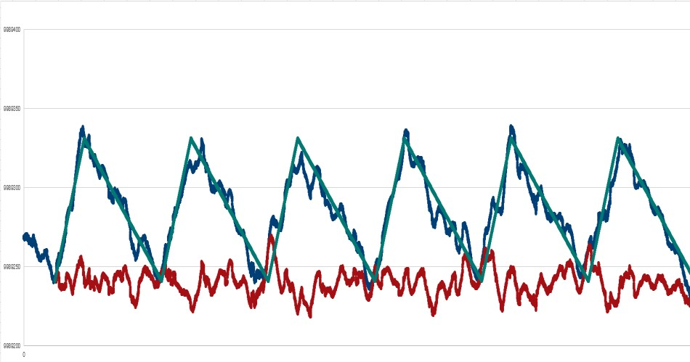
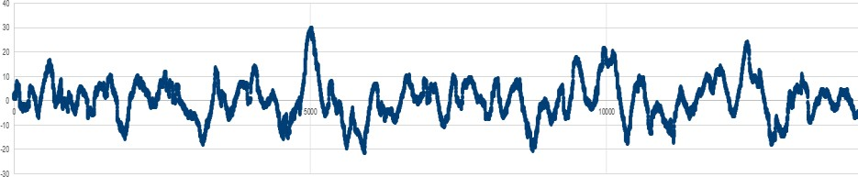
OCXO BYPASS
If OCXO is bypassed, largest error removed, but still periodic 100 ns error visible
SFN regulator causes periodic error. If mitigated, we would expect less than 50 ns error
Residual error Timing error Systematic effect
Residual error: 50 ns

Slide 19
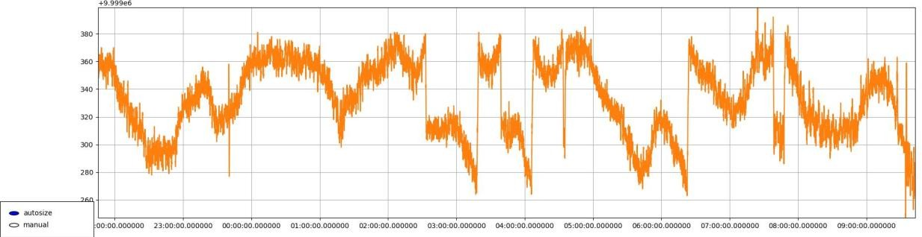
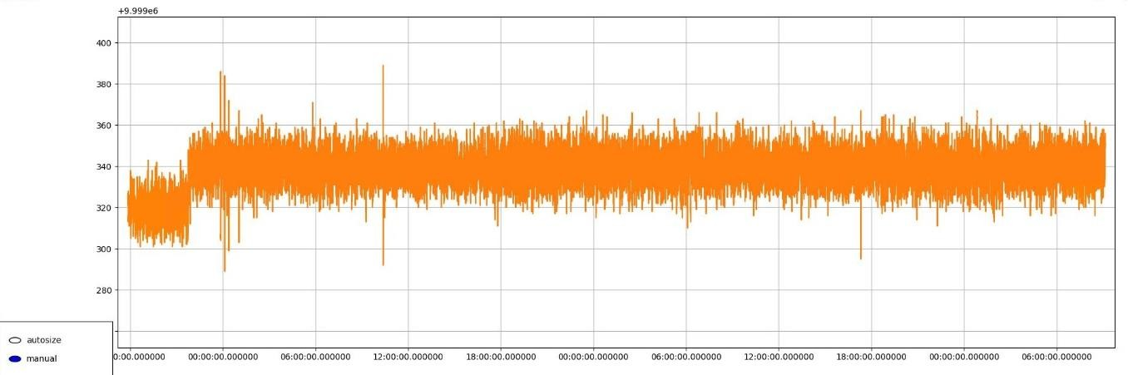
OCXO AND SFN OPTIMIZATION
Timing error < 40 ns
Remaining timing error (< 100 ns) after improvement of OCXO PID controller, without bypass
Remaining timing error ( < 40 ns) after improvement of OCXO PID
controller and SFN regulator

Slide 20
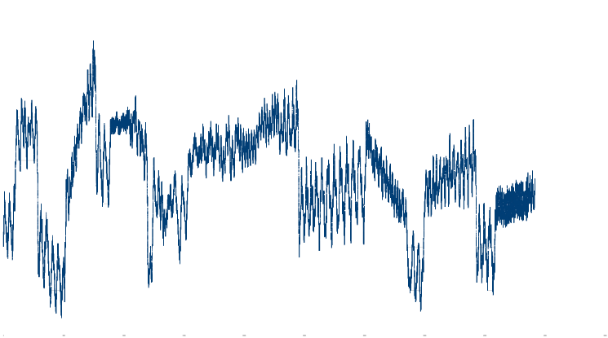

SUMMARY TRANSMITTER IMPROVEMENTS
TV transmitter jitter
reduced from 300 ns to 40 ns
Further improvement technically possible
SW update

Slide 21
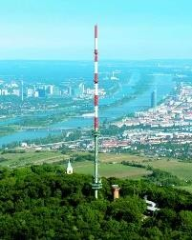

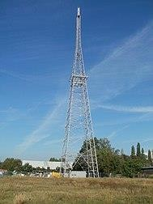
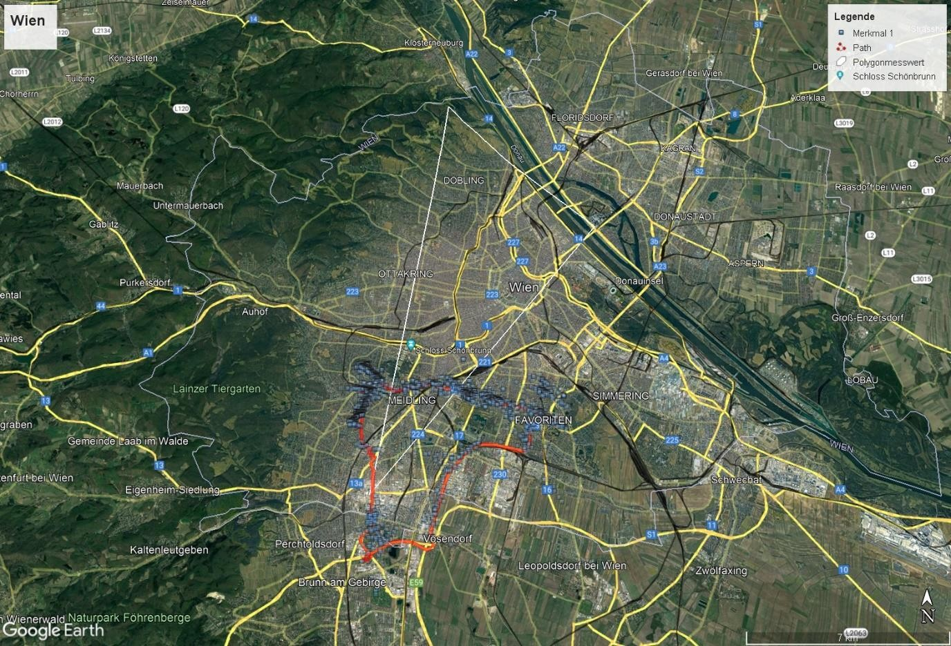
FIELD TESTS –
VIENNA TEST BED
TX1
TX2
TX3
TX1
3 HPHT sites from ORS in Vienna:
TX1: Kahlenberg, ca. 40 kW ERP
TX2: DC Tower,
ca. 10 kW ERP
TX3: Liesing, ca. 10 kW ERP
UHF band, 666 MHz
5 MHz bandwidth
TX2
TX3

Slide 22
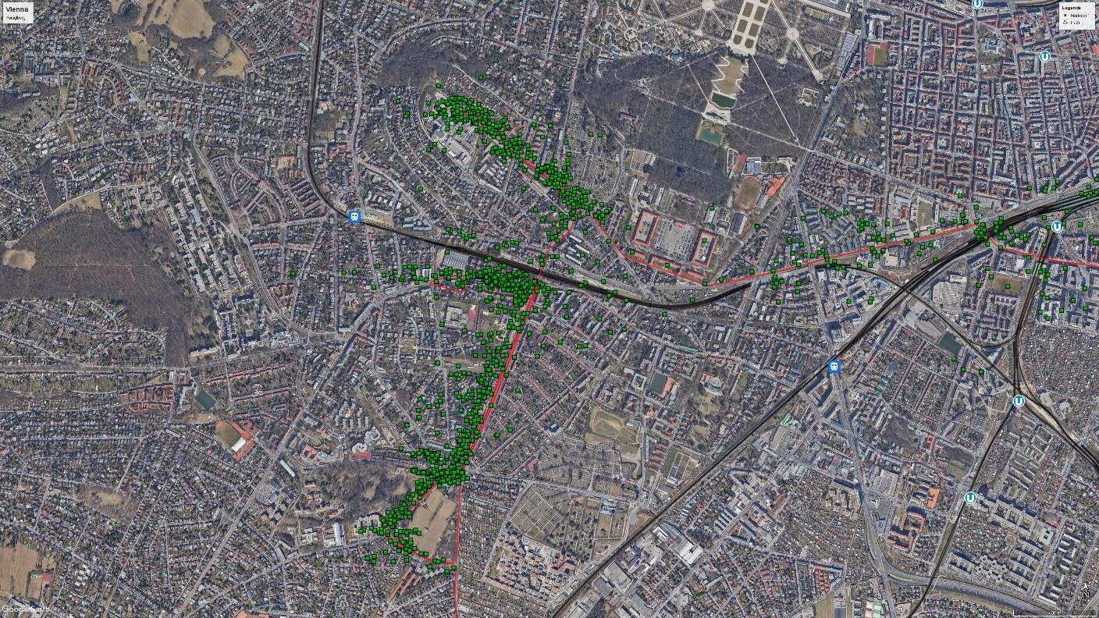
FIELD TESTS – URBAN / SUBURBAN ENVIRONMENT
Scatter Plot at Küniglberg

Slide 23
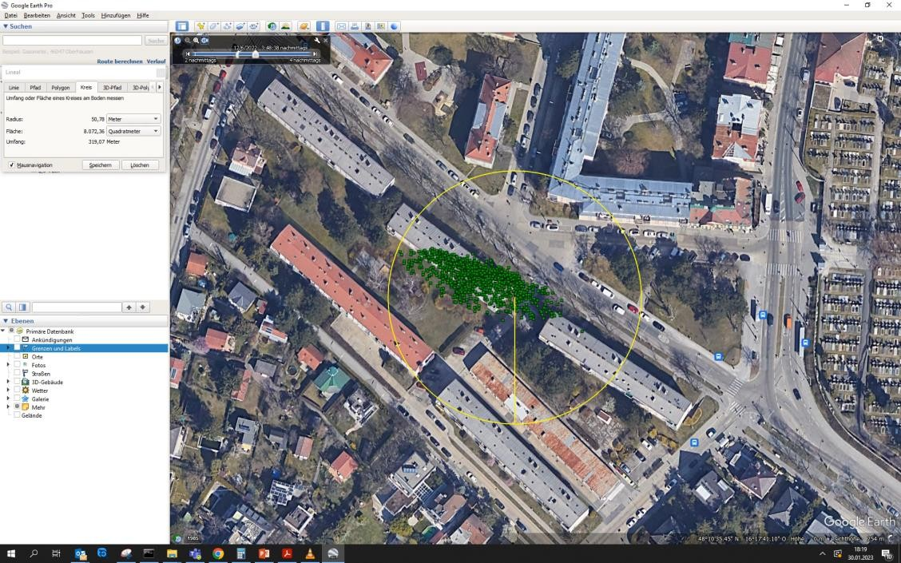
FIELD TESTS – STATIC LOCATION SCATTER PLOT
50m radius
Slowly moving due to uncompensated clock drift of non-ideally synchronized transmitters
Effect of external GPSDO, not the transmitters themselves
Inaccuracy due to transmitter jitter is lower, estimated ~30 m

Slide 24
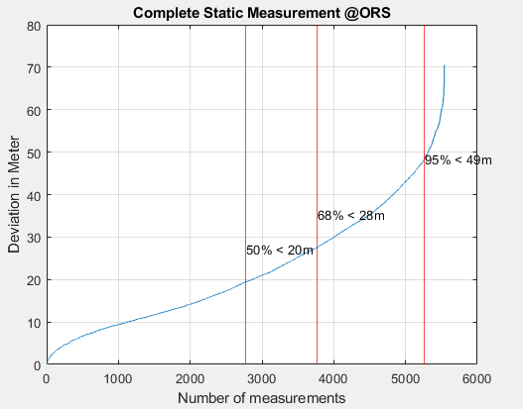
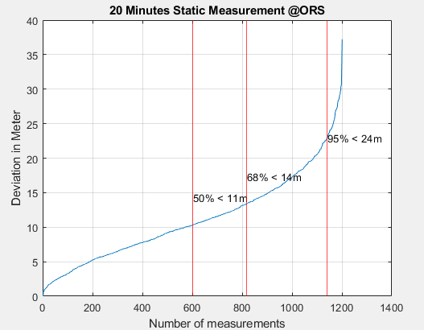
FIELD TESTS – STATIC MEASUREMENT AT ORF HQ
Receiver at the rooftop of the ORF headquarter at a fixed position during the measurement
Overall scatter cloud
slowly moved over the time
First 20 minutes of the test were also evaluated. The remaining uncertainty was only 11 m for 50% and 24 m for 95% of the valid fixes.

Slide 25

3 – NETWORK SYNCHRONIZATION
Cíeated with Bing image cíeatoí

Slide 26
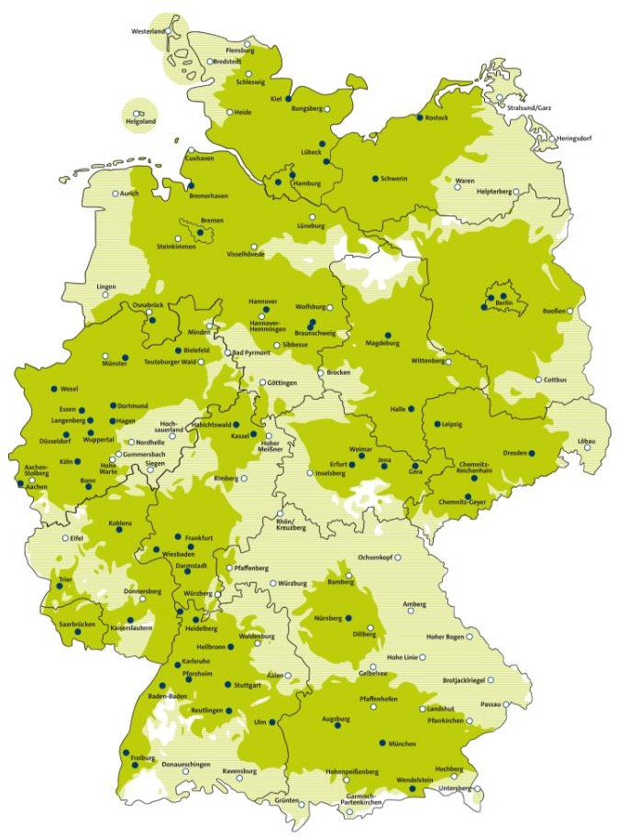
HOW TO SYNCHRONIZE?
TV transmitters have a broadband link to playout centers
Historically: P2P-Microwave
Nowdays: sometimes fiber
More often still microwave
If Fiber:
PTP(WR)
If Microwave:
Proprietary systems for ns-level sync available
PTP-over-microwave:
Unknown performance
Feedback from audience?
Source: http://www.dvb-t2hd.de/

Slide 27
HOW TO SYNCHRONIZE?
Hypothetical P2P microwave backbone for Bavaria
Good coverage for sub µs
time
High-end users could also directly tap the backbone
For ns-level time
Hypothetical timing backbone
between transmitters
Potential direct tap for a high end user
Source: http://www.dvb-t2hd.de/

Slide 28
SUMMARY
Using an improved network of tightly UTC-synchronized TV transmitters
2nd source beside GNSS for PTP masters
~40 ns accuracy possible with SW updates
UTC
Accuracy close to GNSS performance
Much better than long wave signals
Much cheaper than a fiber link with PTP from NIST
Supporting mobility
NIST
PTB
USNO
TV
network
GPS
5G cellular
DVB-T2 FM UTC Time RDS
DCF77
WWVB
TV Signal
GNSS
s
ms
µs
ns
ps
PTP
client
PTP
client
PTP
master
NTP
PTP
PTP-WR
Rohde & Schwarz
12/06/2023 5G based PNT Using TV Transmitters

Slide 29
QUESTIONS, FEEDBACK?
Thank you for your attention!
Project was co-funded by ESA NAVISP Element 2
Rohde & Schwarz
12/06/2023 5G based PNT Using TV Transmitters

Slide 30
BACKUP SLIDES
Rohde & Schwarz
12/06/2023 5G based PNT Using TV Transmitters

Slide 31
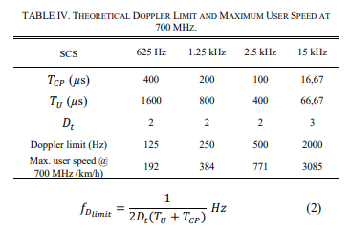
EXCURSION: CELL SIZE, CYCLIC PREFIX AND SUBCARRIER SPACING
If the distance between two neigboring towers increased, the time difference of their signal at receiver increases
In a single-frequency-network, all transmitters send same signal → multiple „echos“ at receiver
If all echos are within the cyclic prefix, signal is improved by each echo
TV towers are further apart than cellular towers → larger cyclic prefix desired
If cyclic prefix is extended, less time for data symbols
Extend duration of OFDM symbols and have less symbols per frame
Need to reduce subcarrier spacing in return
Less subcarrier spacing: Less doppler resilience
https://5g-xcast.eu/wp-content/uploads/2019/05/TBC_NRMBMSforTB_2019.pdf
Rohde & Schwarz
12/06/2023 5G based PNT Using TV Transmitters

Slide 32
THE SAME TIMING RECEIVER COULD USE TV AND CELLULAR SIGNAL AS SOURCE
An feMBMS timing receiver could easily also receive LTE signals with time information
Rohde & Schwarz
12/06/2023 5G based PNT Using TV Transmitters

Slide 33
HOW ARE TV TRANSMITTERS ORGANIZED
In Europe, Africa and most of Asia:
ITU decided a frequency scheme (GE06) that assigned frequencies to regions, in a way that neighbor regions are not affected.
One region might be served by a Single-Frequency network instead of a single transmitter
Regions are using different frequencies
E.g. Germany uses the whole 450-690 MHz range, but each region has only six 8 MHz channels that can be used
In US, FCC decides on TV stations
Recently, spectrum was re-packed. Less use of SFNs, more high-power transmitters
Rohde & Schwarz
12/06/2023 5G based PNT Using TV Transmitters

Slide 34
WHY NOT DIRECTLY USING A CELLULAR NETWORK‘S TIME?
Dependency on electric grid
Most cell networks have only limited backup power, e.g. for 30 minutes
More difficult and costly to guarantee a time synchronization in 10000+ basestations, vs. ~100 TV
towers (taking Germany as an example)
But: If your cellular network operator offers you SIB16: Why not?
Rohde & Schwarz
12/06/2023 5G based PNT Using TV Transmitters

